Slide 1
Non Blocking I/O
Dr. Mohammed Abdalla Youssif
1

Slide 2
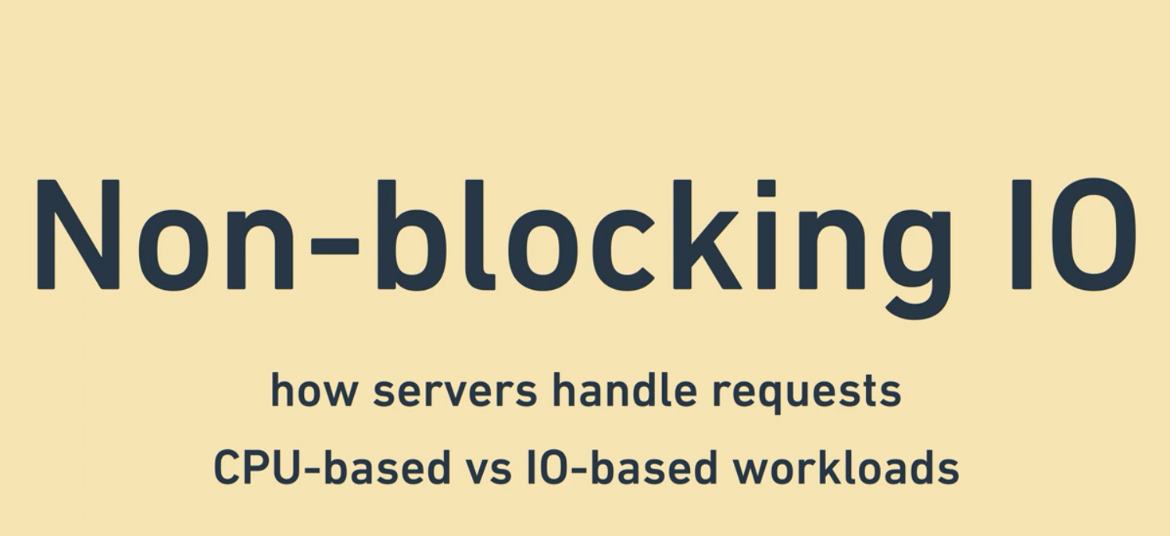
2
Notes:
Non blocking IO and how the run becomes superfast
What is the non blocking IO and what is its help?
That is the question need to be answered today
Along the way, the lecture explores how the servers handle the requests and the differences between CPU based workloads and IO workloads
2

Slide 3
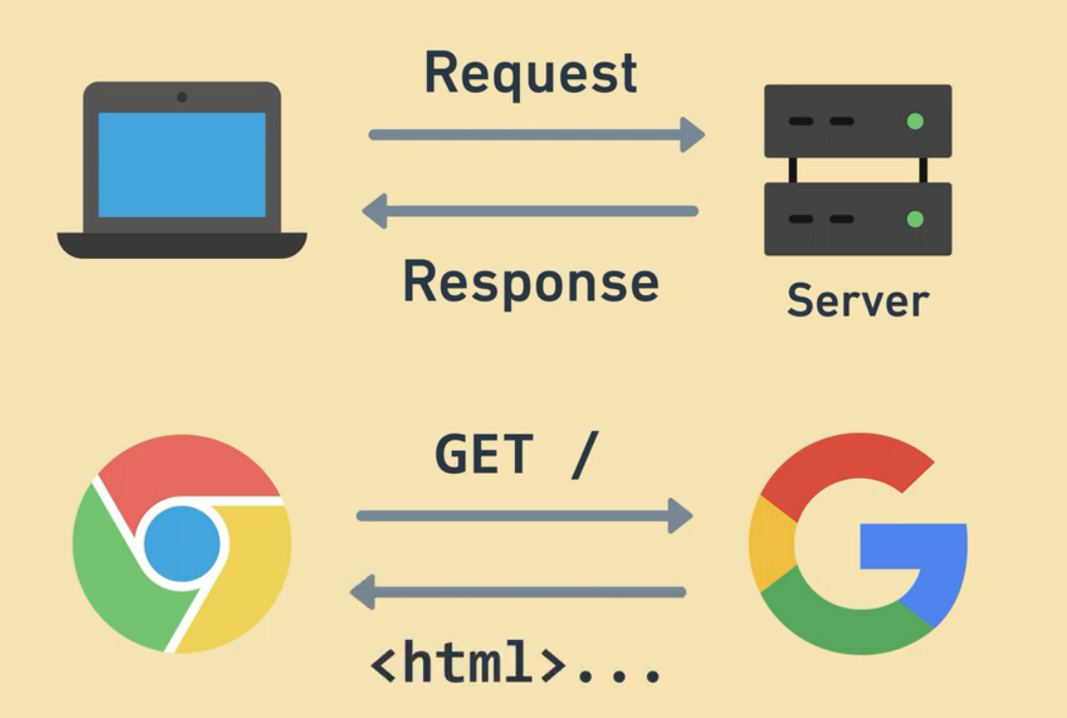
Server is something that receives requests, does some work to compute the response and send response back, often times this is http servers that serve websites & APIs.
Ex: send request to google server, compute html response, send response back and display it in the browsers.
3
Notes:
Servers and threads as an overview.
3

Slide 4
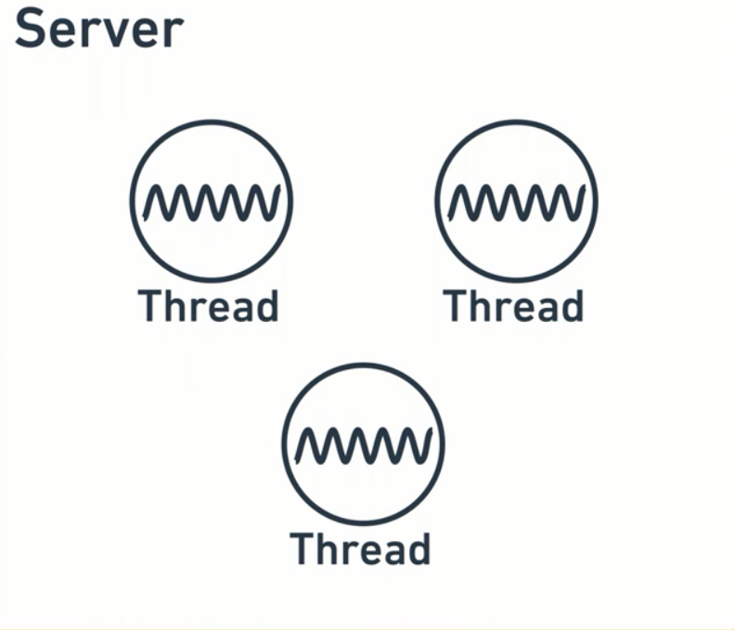
4
Notes:
inside the server, several threads divide the work between them, each thread represent a single worker that does work.
4

Slide 5
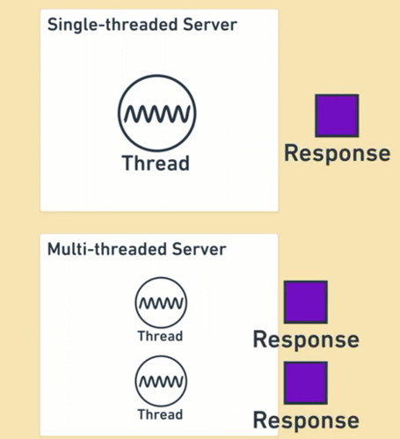
Single thread server → Has one worker that handle the request
Multi thread server → Has multiple workers that handle the requests at the same time.
5
Notes:
5

Slide 6

Single waiter serves single request.
One Waiter is like one thread, requests are like the parties come in.
What about 2 parties in the restaurant at the same time, I think one waiter can server only one request at time.
6
Notes:
6

Slide 7

Imagine you have 2 requests and one waiter needs to serve the two requests at the same time.
Starts by the first one, gives him menu, then move to second one, then move to first one for helping him, then switch to second one for help … etc.
7
Notes:
7

Slide 8
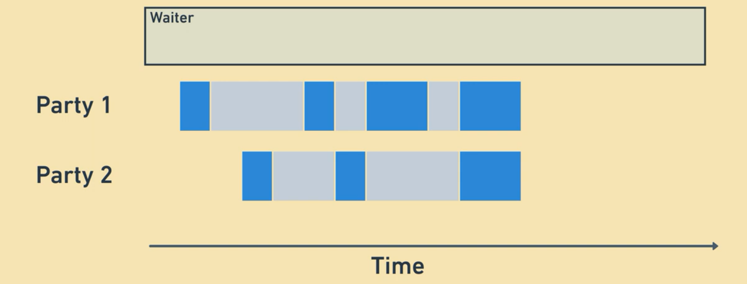
Party 1 comes in, then waiter serve the request .
Then, other party comes in, so waiter switching between them.
Till the end, now both parties need help at the same time. The waiter can only help one of them and the other can wait a little longer than the other party as shown in the next slide.
8
Notes:
8

Slide 9
Party 1 comes in, then waiter serve the request .
Then, other party comes in, so waiter switching between them.
Till the end, now both parties need help at the same time. The waiter can only help one of them and the other can wait a little longer than the other party as shown in the next slide.
9
Notes:
9

Slide 10
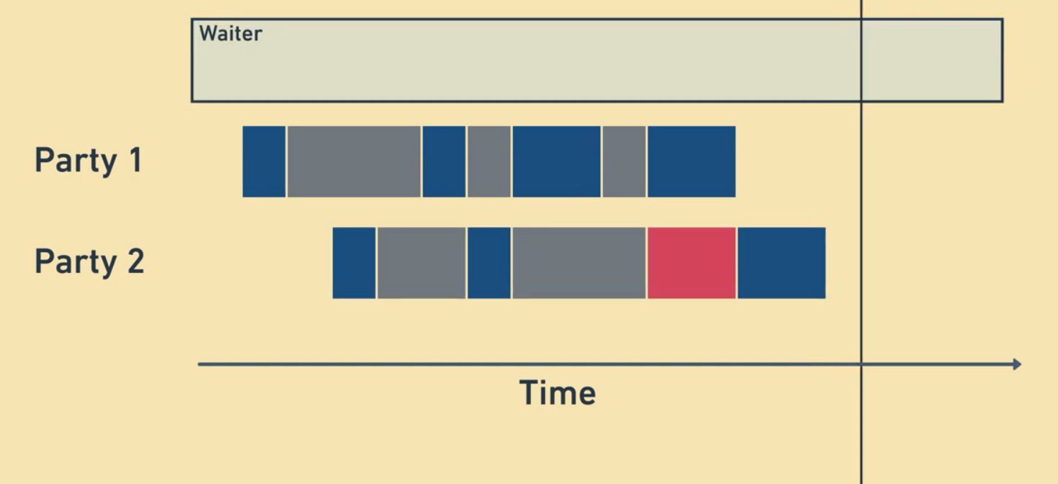
- Down time is in red.
10
Notes:
10

Slide 11
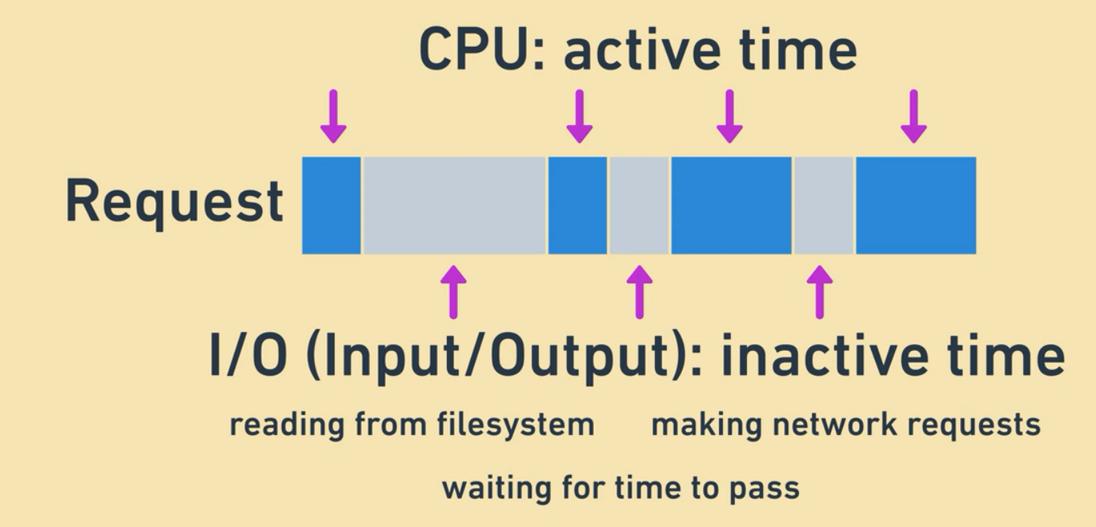
CPU time → is named active attention.
I/O time includes: reading from file system, making network requests, waiting for time to pass.
Reading from file system is same as an example of reading a menu until the waiter finish requests in his hand.
CPU is active consuming or thinking, but IO is waiting something else to happen.
11
Notes:
11

Slide 12
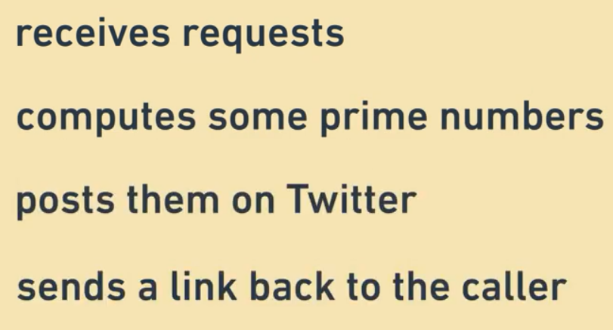
To make things more concrete. We will take a look for example of Pseudo code that
12
Notes:
12

Slide 13
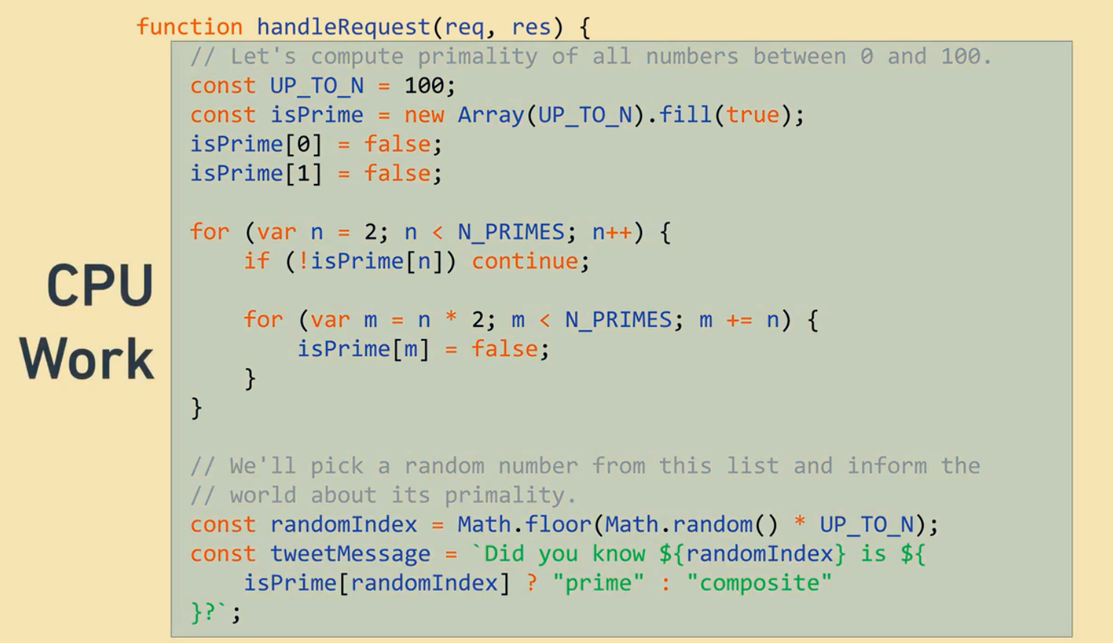
13
Notes:
13

Slide 14
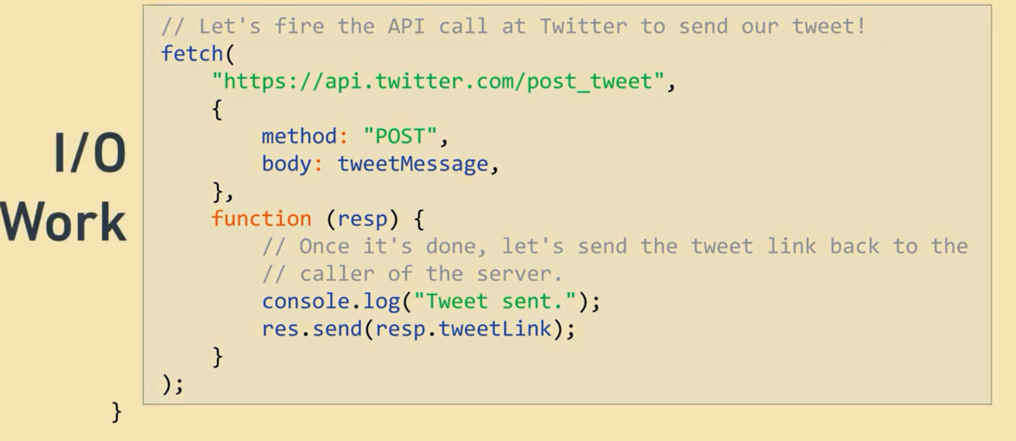
Post the tweets is an example of IO.
IO time between sending request to twitter and twitter response.
14
Notes:
14

Slide 15
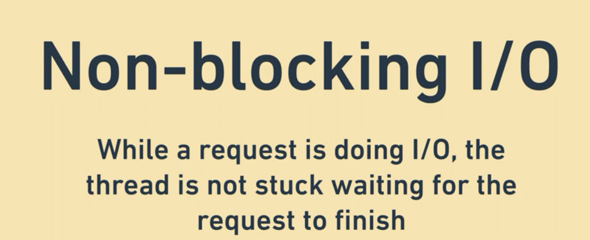
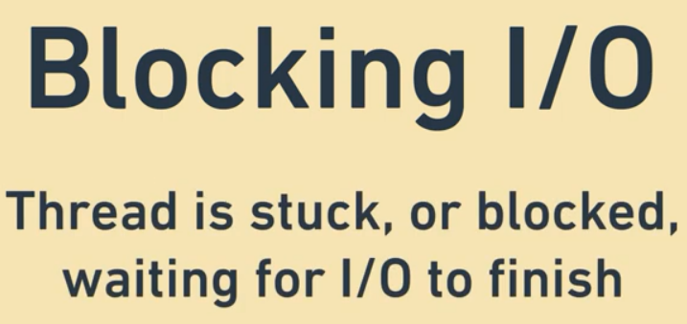
15
Notes:
Non blocking IO saves the response time.
15

Slide 16


16
Notes:
16

Slide 17
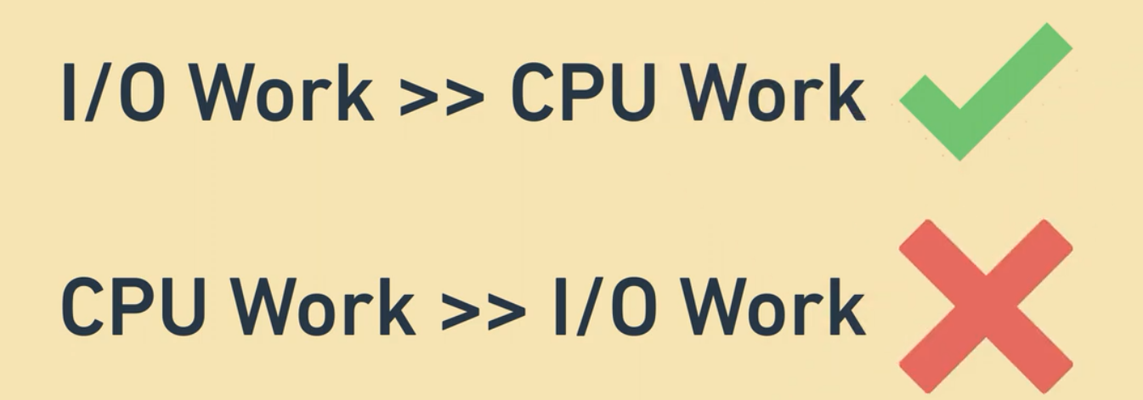
17
Notes:
17

Slide 18
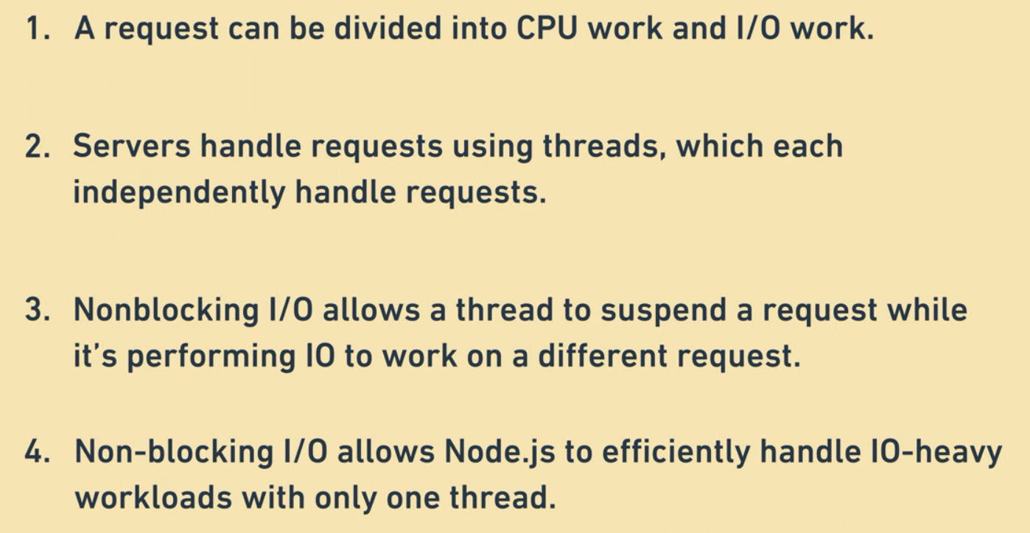
Recap.
18
Notes:
18

Slide 19
Questions ?
19
Notes:
19

